Slide 1
Improving Software Testing With The Use of Metrics
Al Sorkowitz
© ♥ A. Sorkowitz (2006)

Slide 2
Topics
Introduction I
Software testing concepts II
A set of practical metrics III
Software complexity metric IV
Appendix A: bibliography

Slide 3
Introduction
Topics
  Software problems in the news
  The cost of inadequate S/W testing
  Crises driven development
  Problems due to growth in size
  How S/W metrics can aid in testing

Slide 4
Wall St Journal Front Page - 5/30/06
Incidents prompts new scrutiny of airplane software glitches.
As program grow complex, bugs are hard to detect: A jet roller-coaster ride
  Boeing 777 had total loss of control for 45 seconds. The crew able to disconnect autopilot (after several tries) and manually fly plane.
  Problem due to Honeywell software.
  Latest generation of jets have over 5 million SLOC
  Boeing 777 in service since 1995. Problems traced to recently installed modifications installed to fix minor navigational flaws.
  Other serious incidents (non fatal) have occurred that are still under investigation.

Slide 5
Software Testing Tale
Washington Post, 1/23/04, headline
Software foul-up led to loss
  AT&T wireless failed To sign Up subscribers
Story
  AT&T losses 100 million dollars due to S/W problems
  Planned three-day operational test of new software took three weeks.
  During that time AT&T sales employees had limited access to the software, and other customer service representatives were virtually locked out of the system

Slide 6
S/W Testing Tale (Cont..)
  Many third party retailers gave up on AT&T wireless because of difficulty in registering sales orders with company
  Several hundred thousand new customers could not be signed-up, estimated loss at $100 million.
Possible scenario
  Pressure to complete testing and go operational ASAP
  Other possible scenarios?
Possible S/W test actions
  We’ll be analyzing two different case studies, of similar problems, with applicable software metrics

Slide 7
The Costs of Inadequate S/W Testing
It’s a well established Software Engineering principle that you don’t save time by doing incomplete testing.
Yet many times, under pressure, rather then admit to a delay in schedule, we agree to incomplete testing, hoping to luck-out
This study investigates the economic impacts of inadequate for s/w testing in the U.S.
Study conducted surveys with both developers and industry users.
Two industry groups were selected for detailed analysis.

Slide 8
The Cost of Inadequate S/W Testing
    The Economic Impacts of Inadequate Infrastructure for Software Testing
    National Institute of Standards & Technology: Planning Report 02-3
    May 2002
    www.nist.gov/director/prog-ofc/report02-3.pdf

Slide 9
TWO SCENARIOS
Inadequate Infrastructure
  Cost reductions if all bugs could be found in the same developmental phase in which they are introduced.
Feasible Infrastructure Improvements
  Cost reductions associated with finding an increased percentage (but not 100%) of bugs closer to the phase in which they are introduced.
  Users were asked to estimate cost savings if the S/W had 50% fewer bugs

Slide 10
Economic Impact on Transportation Manufacturing Sector (Automotive and Aerospace)
Study focused on the use of Computer-Aided Design (CAD), Computer-Aided Manufacturing (CAM), Computer-Aided Engineering (CAE), and Product Data Management (PDM).
Interviews were conducted with 10 S/W developers (vendors), and 179 users of these products.
Users reported an average of 40 major and 70 minor bugs per year.

Slide 11
ECONOMIC IMPACTS
Inadequate Feasible
Infrastructure (Mil) Infrastructure (Mil)
S/W Developers
CAD/CAM/CAE/PDM $373.1 $157.7
S/W Users
Automotive $1229.7 $377.0
Aerospace $237.4 $54.5
Total $1840.2 $589.2

Slide 12
Economic impact on Financial Services Sector
Study focused on developers and users of Financial Electronic Data Interchange (FEDI) and clearinghouse s/w, as well as the s/w embedded in routers and switches that support electronic data exchange.
Four s/w developers, and 98 users.
Users reported an average of 40 major and 49 minor bugs.

Slide 13
Economic Impacts (cont.)
Inadequate Feasible
Infrastructure (Mil) Infrastructure(Mil)
S/W Developers
Router and switch $1897.9 $975.0
FEDI and clearinghouse $438.8 $225.4
S/W Users
Banks and savings inst $789.3 $244.0
Credit Unions $216.5 $68.1
Total $3342.5 $1512.6

Slide 14
Economic Impacts (cont.)
The findings from these two industry groups were then used as the basis for estimating the total economic impacts for the U.S. manufacturing and service sectors.
The national annual costs of inadequate software testing is estimated to range from $22.2 to $59.5 billion.
Over half these costs are borne by s/w users in the form of error avoidance and mitigation activities.

Slide 15
The Chaos in Software Development
A major survey of 13,522 Information Technology projects.
  Project Success - Completed on-time, within budget, all functionality - 34%
  Project Failure - Cancelled prior to completion - 15%
  Challenged Projects - Over budget, late, less functionality - 51%
    Average cost overrun - 43%
    Average time overrun - 82%
    Required features - 52%
    Standish Group International Inc
    CHAOS Report

Slide 16
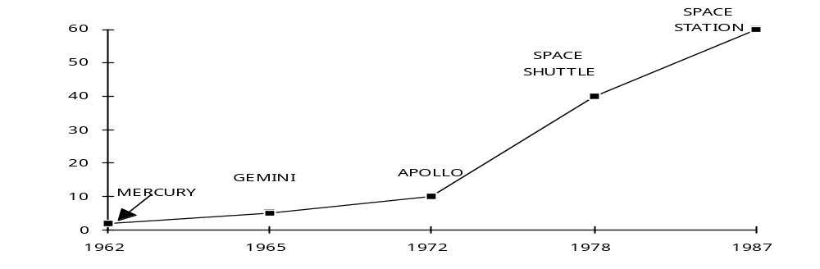
Software Growth - NASA
S/W Growth

Slide 17
Software Growth
Operational Code
SAGE (1950s) 100,000
Air Traffic Control (1960s) 200,000
Safeguard (1970s) 750,000
NORAD-SPACECOM(80s) 2,000,000
AN/BSY-2 (1990s) 3,200,000

Slide 18
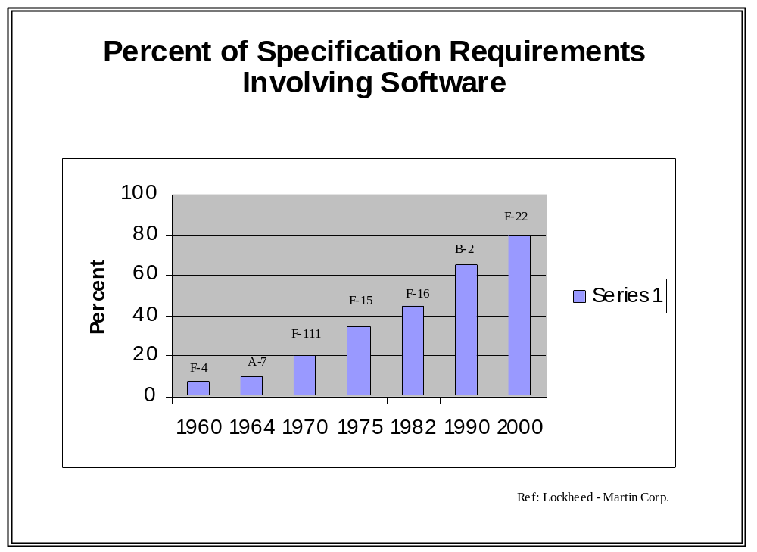

Slide 19
Problems Due to Growth in S/W Size
Complexity scales non-linearly with size
  Double the LOC and the complexity (error rate, time to market, etc,) goes up by more then a factor of two.
Scaling-up requires fundamental process changes

Slide 20
How S/W Metrics Can Aid in Testing
Increase understanding of your s/w process.
  How much are we spending on unit, integration, system, regression, and beta testing?
  How many “requirement errors” do we catch in system testing.
Aids in managing S/W projects..
  Tracks actual testing progress against planned progress. Are we on schedule?
Guide Improvements to your S/W process
  Provides insights for improving s/w test process.

Slide 21
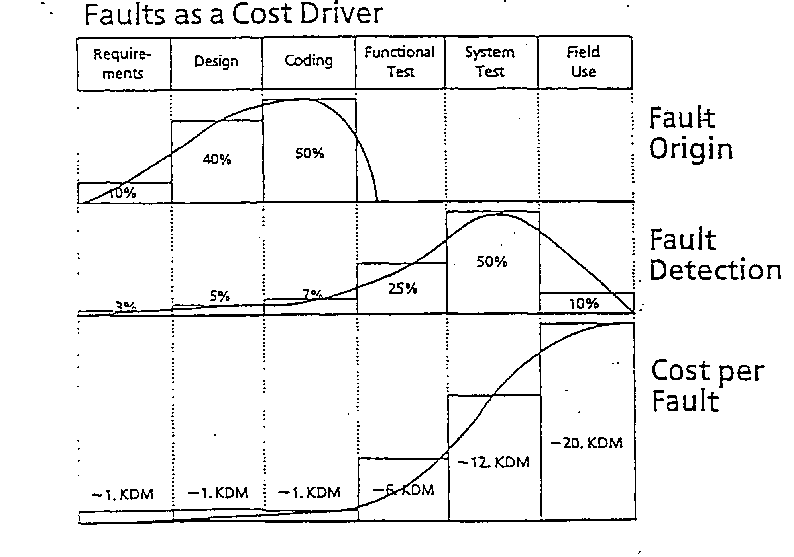
Capturing and Using Test Measurements to Set New Goals

Slide 22
Air Force Directive on Metrics
From: Under Secretary of Air Force
Subject: Revitalizing the Software Aspects of System Engineering
Dated: Sep 20, 2004
This policy memorandum is intended to improve the efficiency and effectiveness of our acquisition process and software management. …
Metrics: Employ a core set of basic software metrics to manage the software development for all developer team members with significant software development/integration responsibilities.
S/w size S/w Development Effort
S/w Development Schedule S/W defects
S/W requirements, Stability S/W Staffing
S/W Progress (Design, Coding, and Testing)
Computer Resource Utilization

Slide 23
Software Testing Concepts
High cost of testing
What is software testing?
Self assessment test
Problems in testing
Economics of testing
Common errors in testing

Slide 24
High Cost of Testing
50% of elapsed time
50% of total costs
  Expended in testing the program, system being developed

Slide 25
TESTING
“It is well known that you cannot test reliability into a software system”
  MILLS, H., ‘Software Development’, IEEE Transactions on SE, December 1976
“…program testing can be used to show the presence of bugs, but never their absence!”
  Dijkstra, E.W., “Structured Programming”, Software Engineering Techniques, NATO Science Committee, 1970

Slide 26
What is Software Testing?
Proving a program is correct
or
The process of executing a program with the intention of finding errors
Problems in testing
  Psychologically destructive
    Is it possible for a programmer to test own program?
Testing at the end of life cycle
  Short cuts are taken to meet schedule/cost
  “Testing is the phase which most disasters finally become evident. It is to late to evade the consequences of inadequate planning, estimating, and defect prevention. Testing is the most misscheduled part of development.” (Brooks)

Slide 27
Self-assessment Test
A program reads three integer values. The three values represent the lengths of the sides of a triangle. The program prints a message that states whether the triangle is scalene,(three unequal sided) isosceles, (two equal sides or equilateral (three sides equal).
Write a set of test cases that will adequately test this program.
Test Case Input Values Expected results
1. 3,3,4 Isosceles
2. 3,4,3 Isosceles
3. 4,3,3 Isosceles

Slide 28
Triangle Problem
If you are typical, you have done poorly. Highly experienced programmers score an average of 7.8 out of a possible 14.
Testing only valid inputs is not sufficient
The point of this exercise is to illustrate that the testing of even a trivial program is not easy.
How did you develop the test data?
  Ad hoc, intuitive, or in a structured manner
Would better requirements (complete) have an impact on the quality of the testing?

Slide 29
Cost of Latent Error Correction
A requirement error Times more costly then
caught in: finding it in the req.. phase
Design 2.5
Code & unit test 5
System test 36
More cost-effective to find and correct errors in early test phases

Slide 30
Is it Possible To Test All Possible Combinations ?
Testing methodologies
Black Box
  Testers unconcerned about internal logic or structure. Treat the code as a “black box”. Test data is derived from functional specs
  Can we test all inputs (valid/invalid ),and all
  combinations of inputs, as well as every way in which a user might try and use the program
White Box
  Tests the internal logic of the code. Test data is derived from knowledge of the logic.
  Can we test all possible paths?

Slide 31
Economics of Testing - Tradeoffs
Objective is to maximize yield on testing investment
Maximize errors found by finite number of tests
Given the constraints of time and costs, what subset of test data, from an infinite number of input and output values and paths, has the highest probability of detecting the most errors?

Slide 32
Common Errors in Testing
Creating too few tests
  Too many bugs
Creating the wrong tests
  Finding minor or low-risk errors, vs. important or high-risk errors
Creating too many tests
  Test cases often redundant
  Expensive

Slide 33
S/W Inspections
A formal evaluation technique in which s/w requirements, design, code, and test documentation are examined in detail by a group of peers to detect faults, violations of development standards, and other problems.
  Fagan (IBM) published paper in 1976
  Increase productivity by finding and eliminating defects early.
  Costs of inspections more then offset by decrease in costs to fix defects later

Slide 34
Inspection Experience
Individual programmers are only 25% efficient in finding bugs in their own software
The sum of all normal test steps is often less then 70% effective ( 1 out of 3 bugs remain)
Requirement, design and code inspectionsctions can lower costs and schedules by as much as 30%
  (Capers Jones)

Slide 35
Testing Axioms
A good test case is one that has a high probability of detecting an undiscovered error, not a test case that shows that the program works correctly.
One of the most difficult problems is knowing when to stop.
It is impossible to test your own program.
A necessary part of every test case is a description of the expected output or results.
Avoid nonreproducible or on-the-fly testing.
Write test cases for invalid and valid inputs.

Slide 36
Testing Axioms (cont.)
As the number of detected errors in a piece of software increases, the probability of the existence of more undetected errors also increases.
Assign your most creative programmers to testing.
Ensure that testability is a key objective in your software design.
Testing, as almost every other activity, must start with objectives.

Slide 37
Software Metrics for testing
Topics
  An Introduction to Metrics
  A Set of “Best Practices” S/W Metrics

Slide 38
Science and Measurement
“When you can measure what you are speaking about, and express it in numbers, you know something about it, but when you cannot measure it in numbers, your knowledge is of a meager and unsatisfactory kind...you have scarcely in your thoughts advanced to the stage of science.” (Lord Kelvin)
What to measure, When to measure, and How to measure

Slide 39
S/W Metrics
Provides a top-level management overview of the software development status
Visibility into testing process
Compare actual progress to plans
Early detection of potential problems
Trends uncovered can be projected to evaluate potential impacts
Points out inconsistencies in interrelated activities

Slide 40
A Set of “Best Practices” S/W Metrics
Metrics for:
  Tracking Testing Progress
  Test Coverage Analysis
  Incident Tracking and Management
  Test Personnel Tracking
  Tracking Software Size
  Tracking The Testing of Software Builds
  Rework

Slide 41
Tracking Testing Progress
Module Level
  Unit Testing
System/Subsystem Level
  Functional Testing

Slide 42
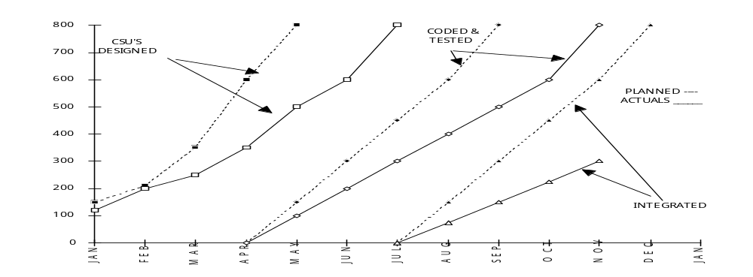
CSU Development Progress
CSCI “X”
*

Slide 43
Testing Progress Metrics
Measures the ability to maintain progress during the System Testing phase.
Corrective Action
  A 20% change, (planned/actuals), requires replanning.
Analysis
  Other metrics to review which may provide insight into problems include Requirements Volatility , Software Size, and Staffing

Slide 44
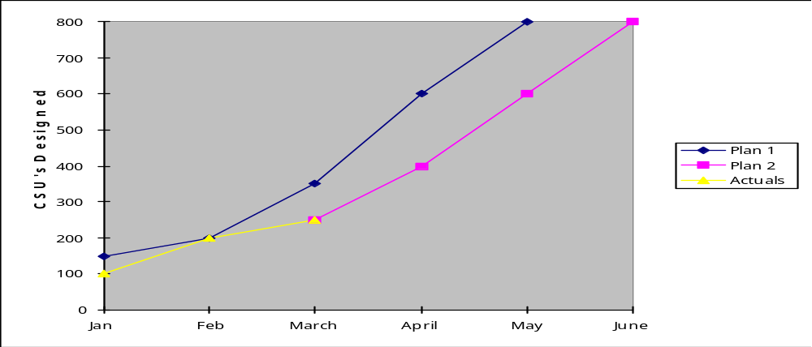
CSU Metric Updated
*

Slide 45
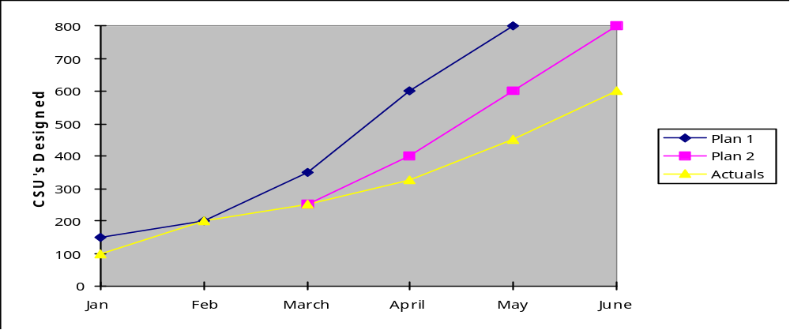
CSU Metric Update (cont)
*

Slide 46
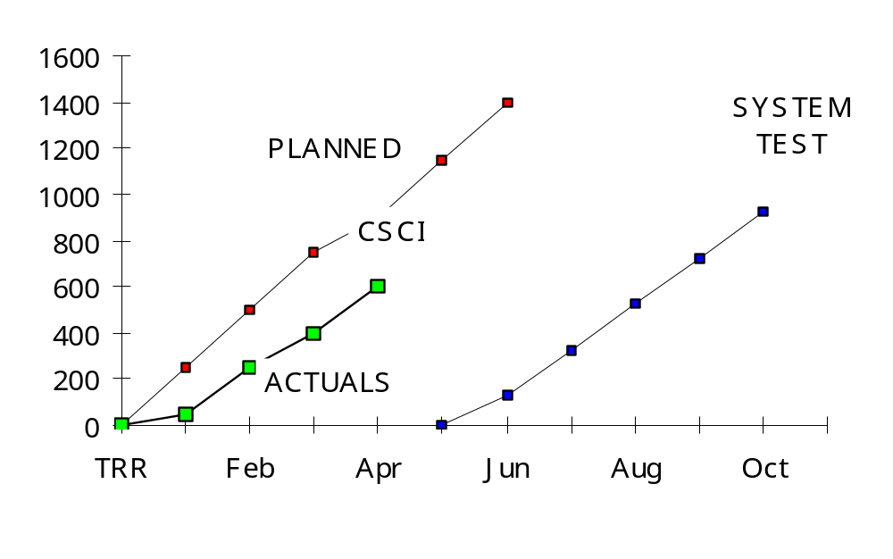
System Testing Progress

Slide 47
Testing Progress Metrics
Measures the ability to maintain progress during the System Testing phase.
Corrective Action
  A 20% change, (planned/actuals), requires replanning.
Analysis
  Other metrics to review which may provide insight into problems include Requirements Volatility , Software Size, and Staffing

Slide 48
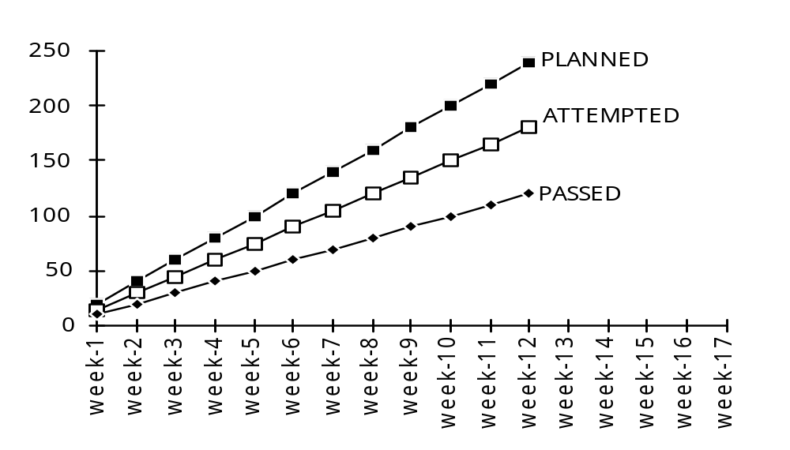
Test Status
*

Slide 49
Test Coverage Analysis
Test Coverage The degree to which a given test or set of tests address all specified requirements for a given system or component. (IEEE Std 610)

Slide 50
Depth of Testing Metric
Provides indicators of the extent of testing performed at the module level (CSU)
Statement Metric - Percentage of the number of executable statements exercised .
Branch Coverage Metric - Percentage of branches (program logic flow) that have been successfully executed.

Slide 51
The Quality of Unit/Module Testing
How is it Presently being done?
Programmer/analyst
  Develops program
  Develops test data
  Decides when modules/programs ready for integration
Who checks the quality of the unit/module testing, and how?

Slide 52
Program Testing Certification
Objective - Improve the quality of unit testing
How
  Assure minimum testing criteria
    Test every branch true/false
    Test every statement
When - After program testing complete
Using automated tools

Slide 53
Certification Process
Program certification request
Program certification results
Program certification waiver

Slide 54
Output of Automated Tool
Execution Counts
True/false path analysis
% of total execution time

Slide 55
Output Example
True False
Path Path
P - Write.
if... 2793 2793 0
next sentence 2793
else 2793
move... 0
add 0
write 0

Slide 56
Certification Testing Summary
Total programs certified
    Certified 1st run 28%
    Certified 2nd run 25%
    Certified 3rd run 11%
    Certified 4th run (or more) 11%

Slide 57
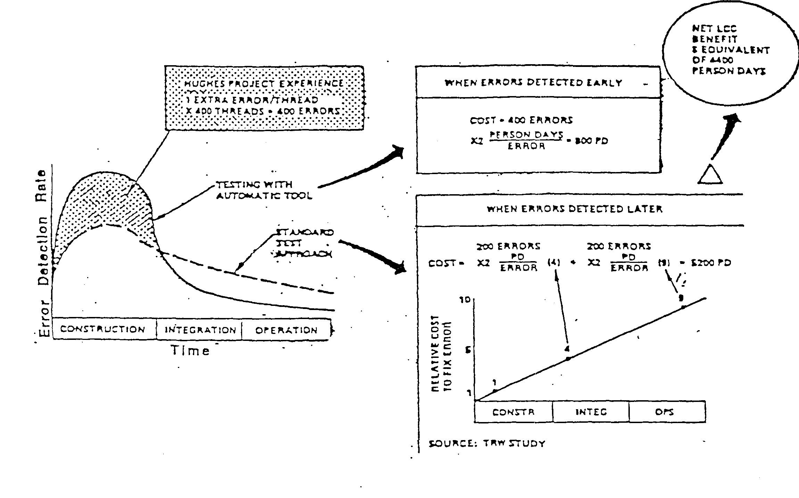

Slide 58
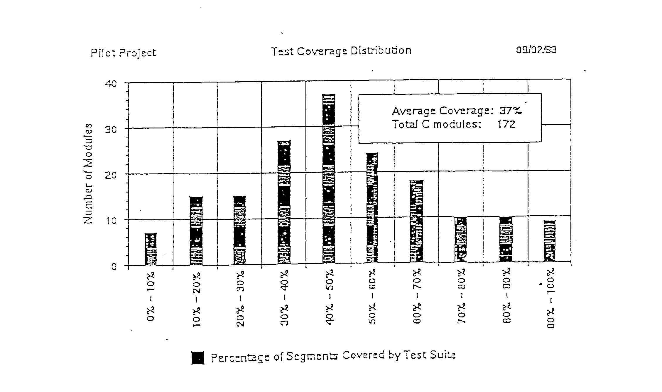

Slide 59
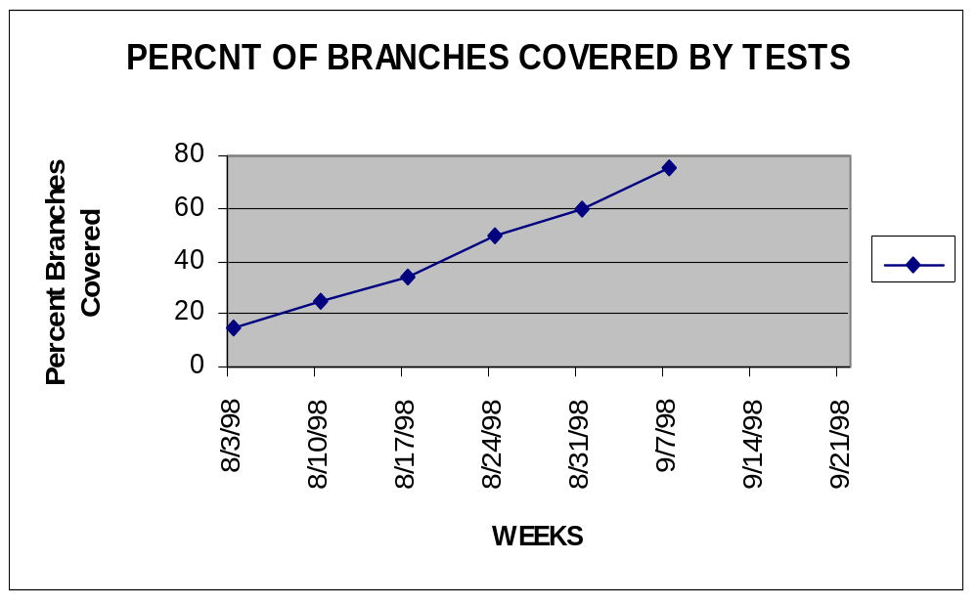
BRANCH COVERAGE

Slide 60
Testing Progress Metrics
Measures the ability to maintain progress during the System Testing phase.
Corrective Action
  A 20% change, (planned/actuals), requires replanning.
Analysis
  Other metrics to review which may provide insight into problems include Requirements Volatility , Software Size, and Staffing

Slide 61
Depth of Testing
Finding areas of a program not exercised by a set of tests
Creating additional tests to increase coverage
Use of automated tools
Measure the quality of a test set, not quality of product
Set minimum percentage coverage for release

Slide 62
Incident Tracking and Management
Software Test Incident - Any event occurring during the execution of a software test that requires investigation. (IEEE Std 610)

Slide 63
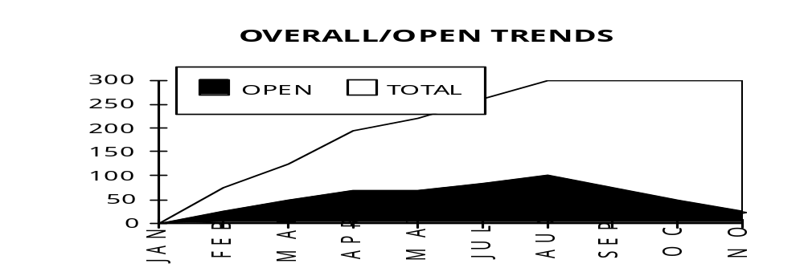
FAULT PROFILES
*

Slide 64
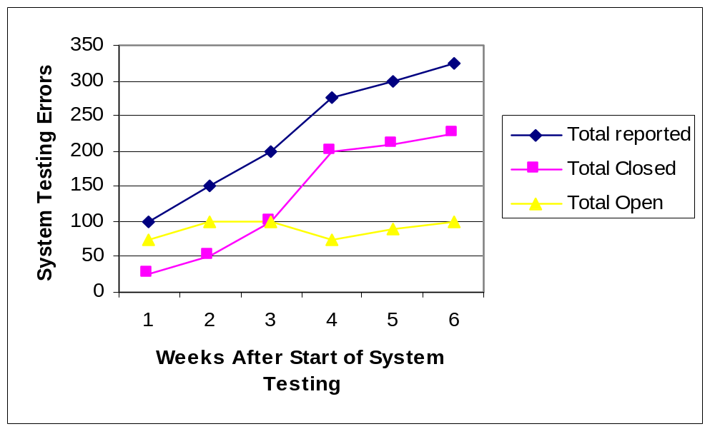
FAULT PROFILES (CSCI/Priority)

Slide 65
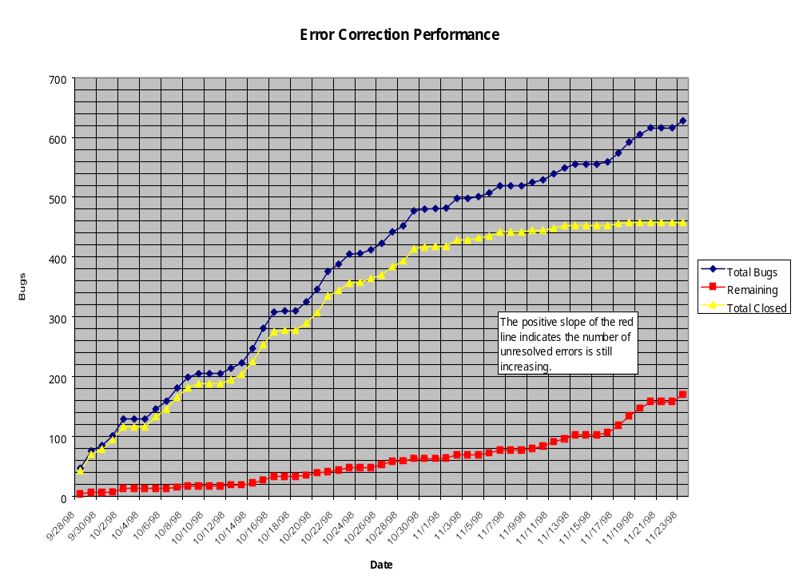

Slide 66
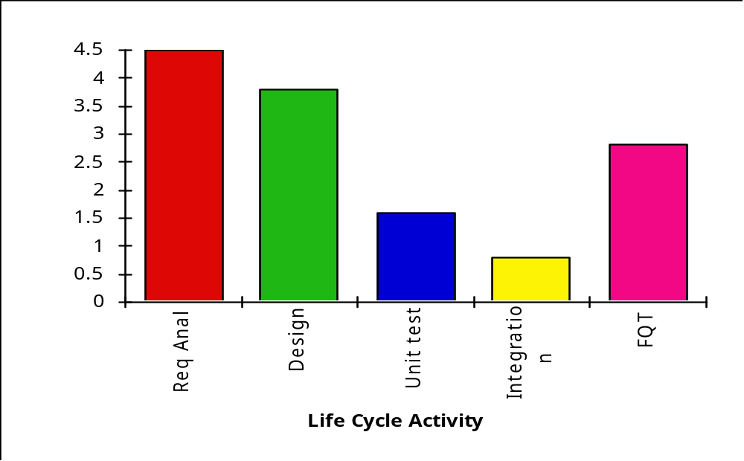
Density of Requirements Defects Found in Different Life Cycle Activities
A low number of faults may indicate a good product or poor testing.

Slide 67
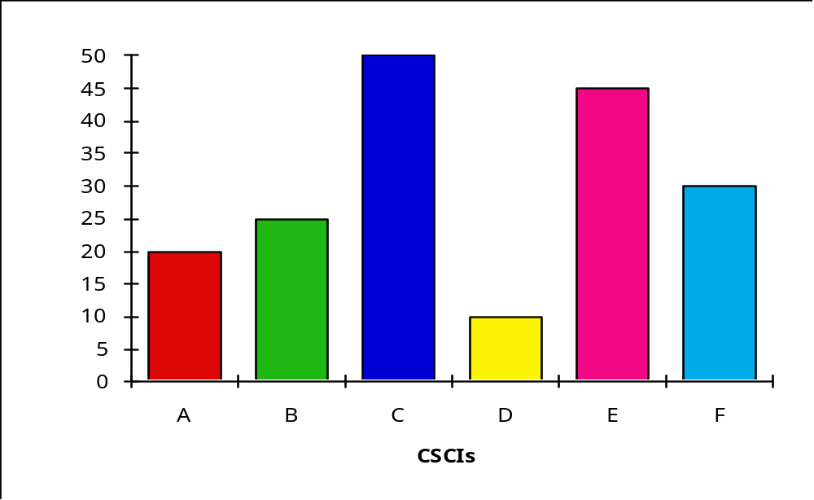
Total Number of Trouble Reports System/Priority

Slide 68
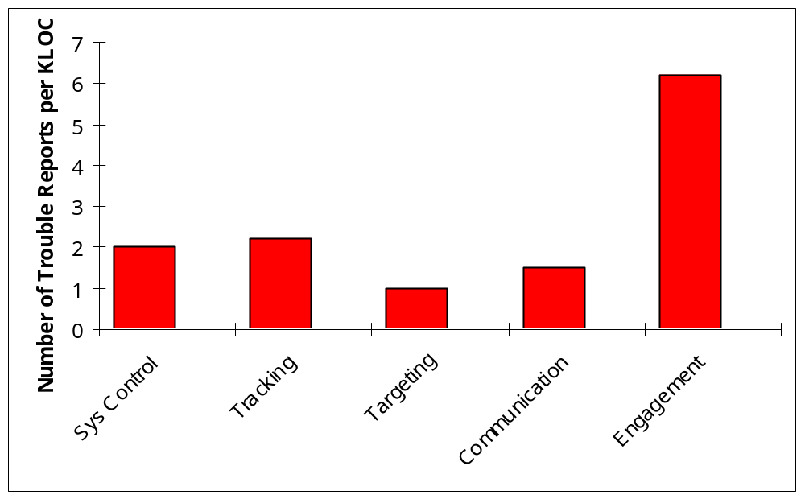
Faults by Functionality

Slide 69
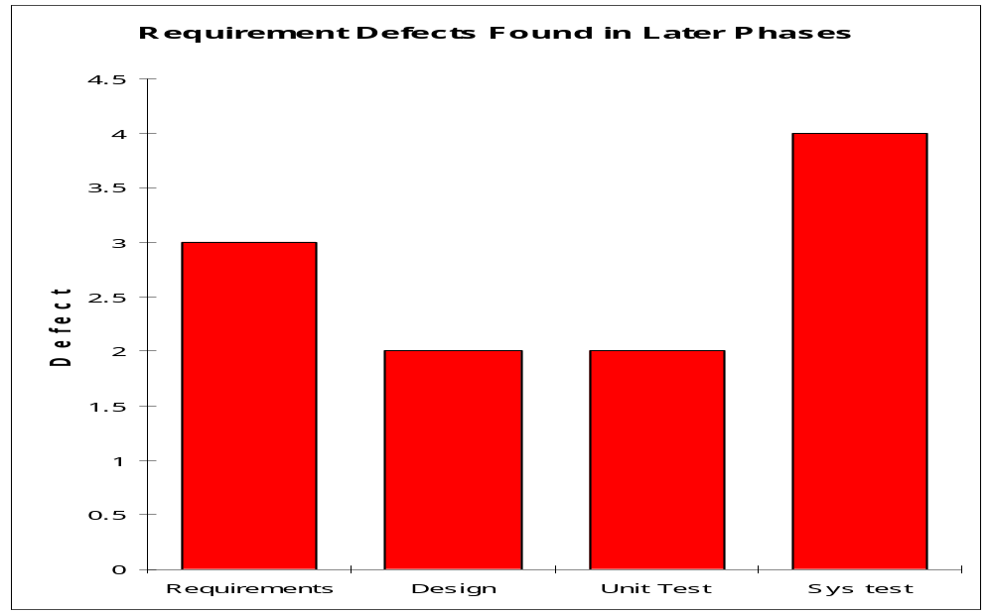
Defect Containment Metric

Slide 70
Defect Containment Metric
Defect Containment Metric measures the effectiveness of the s/w process to contain defects to the phase they were introduced. It identifies which phases the defect was introduced, and which phase the defect was found. This metric provides insight into where to invest in process improvement.
Defect severity is high, med, low.
Analysis
  If previous historical Defect Containment data is available, an analysis is made of - present versus historical Defect Containment. If difference is greater then 20%, an investigation of cause is performed. Cause(s) may be one or more of the following:
    S/W process is not being followed.
    Staff not trained in process
    System more complex then planned.

Slide 71
Defect Containment Metric (cont.)
  Defect severity is high, med, low.
Analysis
  If previous historical Defect Containment data is available, an analysis is made of - resent versus historical out-of- phase data is performed. If difference is greater then 20%, an investigation of cause is performed. Cause(s) may be one or more of the following:
    S/W process is not being followed.
    Staff not trained in process
    System more complex then planned.

Slide 72
Incident/Fault Profiles
Provides insight into the quality of the software as well as the developers ability to fix known bugs.
Plots the number of problems. And the number of open problems against time.
S/W should not be released for System Testing if open priority one or two problem’s are present.
A leveling off of the cumulative number of total problem’s may indicate that the s/w has reached maturity, or that testing has decreased.

Slide 73
Open Source Fault Tracking Systems
Two Free Open Source Systems
Bugzilla
  www.bugzilla.org/docs
  You can try it out on the internet before installing it
  http//bugzilla.mozilla.org/enter_bug.cgi
ITRACKER
  http//sourceforge.net/projects/itracker

Slide 74
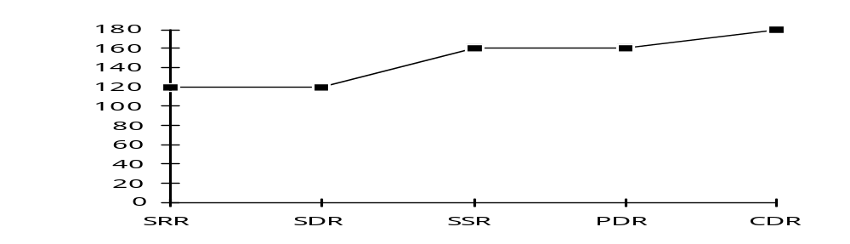
Software Size
Size

Slide 75
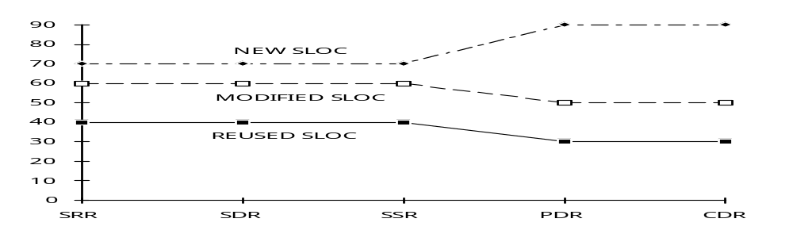
Software Size
Size

Slide 76
Software Size Metrics
Tracks changes in the software size
Size is a major variable used to estimate developmental effort and schedule
Unplanned increases can adversely effect schedule and cost.
Tailoring - Each System/Subsystem
Corrective Actions
  Increase over 5% per reporting period, or over 20% between end of phase reviews requires a cost/schedule impact.
Analysis
  S/W size should not exceed thresholds without a detailed understanding of the reasons for the change, and an understanding of the cost, and schedule impacts.
  Changes in size often result from a better understanding of the requirements.

Slide 77
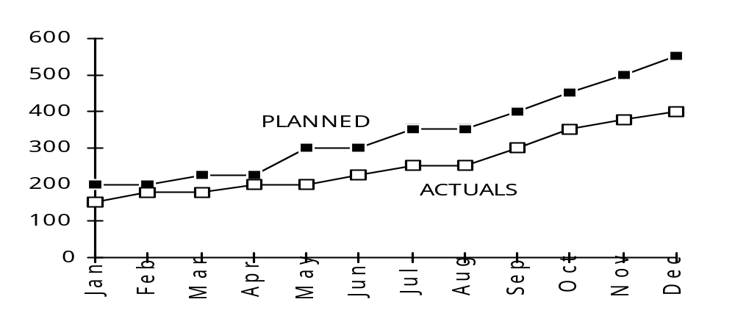
Software Test Personnel
*

Slide 78
Software Personnel Metrics
Tracks ability to maintain planned staffing levels
Corrective Action
  Changes of 20% against planned levels, measured over the complete software life cycle requires a cost/schedule impact, and revised plan.
Tailoring idea
  Report staffing separately for senior people, unique skills.
Analysis
  Adding staffing late in a project may not improve schedule
  Intelligent use of overtime, and alternative shifts may help
  A high turnover rate in an indication of problems, which should be identifies and managed.

Slide 79
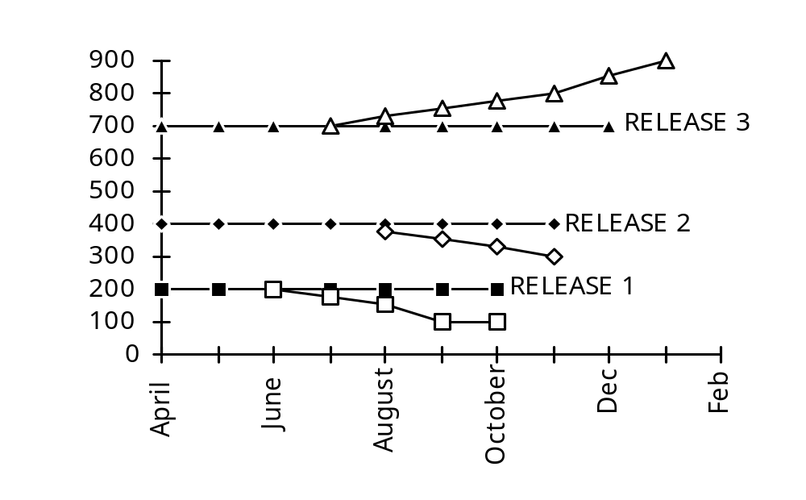
Incremental Release Content

Slide 80
Tracking The Testing of Software Builds
Incremental Release Content Metric
Tracks the schedule and the content per release (software build) in order to monitor the ability to preserve schedule and functionality in each release.
  Analysis
  Decreases in the number of modules per release may indicate the off-loading of functionality from an early release to a later release. This should include justification for the move, and plans for the later releases.
  Deferments to later builds without adjustments to the schedule are of greatest concern. A 5% or greater variance in a single build, or a 10% variance across two or more builds should be considered significant

Slide 81
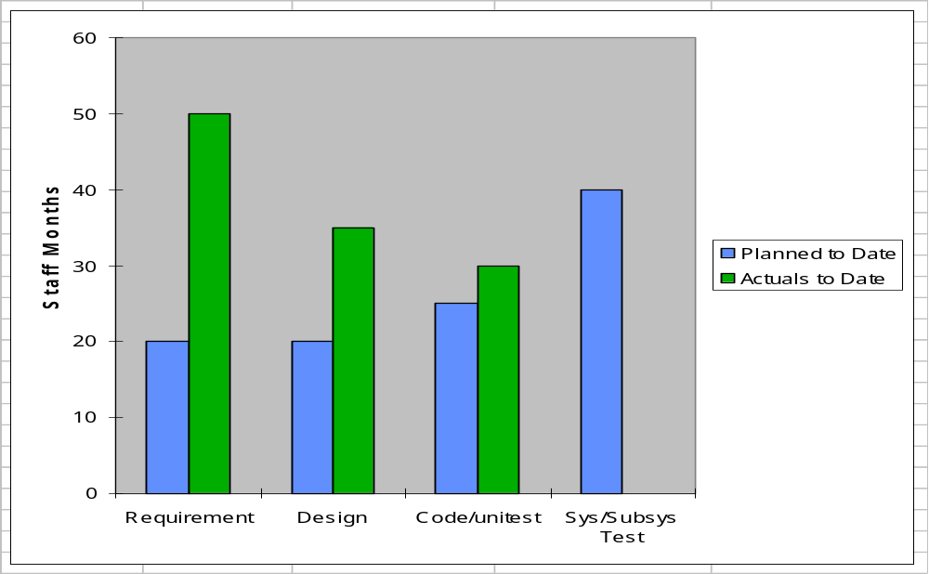
Rework (by activity)

Slide 82
Rework Effort Metric
Tracks effort to fix defects
  Compares amount of rework effort against budget for rework
All programs experience rework,it should be planned
Achieving lower amounts of rework requires early defect control techniques such as reviews and inspections
  Rework can also be tracked using review/inspection and problem report data

Slide 83
Software Measurement Principles
Project Issues and objectives drive the measurement requirements.
The developers process defines how the software is actually measured.
Collect and analyze data at a level sufficient to identify and isolate problems.
Interpret measurement results in the context of other project information.
Integrate software measurement into the s/w life cycle.

Slide 84
Metric Benefits To The Test Manager
Metrics by themselves do not control or improve anything. They give insights for planning, managing, and a basis for objective communications.
Historical metric data helps estimations, predictions and planning
Actual versus plan data helps determine progress and support decision making
Analyzing trends helps identify and focus on problem areas

Slide 85
Mapping Software Issues To Metrics
Are we making progress towards schedule?
  Requirements/Design Progress metrics
  Program Progress Metrics
  System Progress Metrics
  Incremental Build Progress Metrics
Are changes impacting the project?
  Software Size metrics
  Requirements/Design volatility metric
Is the staffing adequate?
  Software Personnel Metric
Is a high quality product being developed?
  Depth of Testing Metric
  Fault Profile Metric
  Defect Density Metric
  Defect Containment Metrics
  Breadth of Testing Metric
  Rework Metric
  Requirements Traceability Metric
  Design/Code Complexity Metric

Slide 86
Managing Boeing 777 Software
Software for Boeing 777
  30 Contractors
  9 million person hours
  Develop, code and test 2.5 million SLOC, 1.6 million COTS
Boeing Management
  Each contractor to initially plan for size (SLOC), design, code and test.
  Biweekly reports on actuals
  Metrics allowed early identification of problems
  Problematic functionality identified 30 months prior to delivery, and deferred until after initial delivery. Early identification freed-up scarce resources.

Slide 87
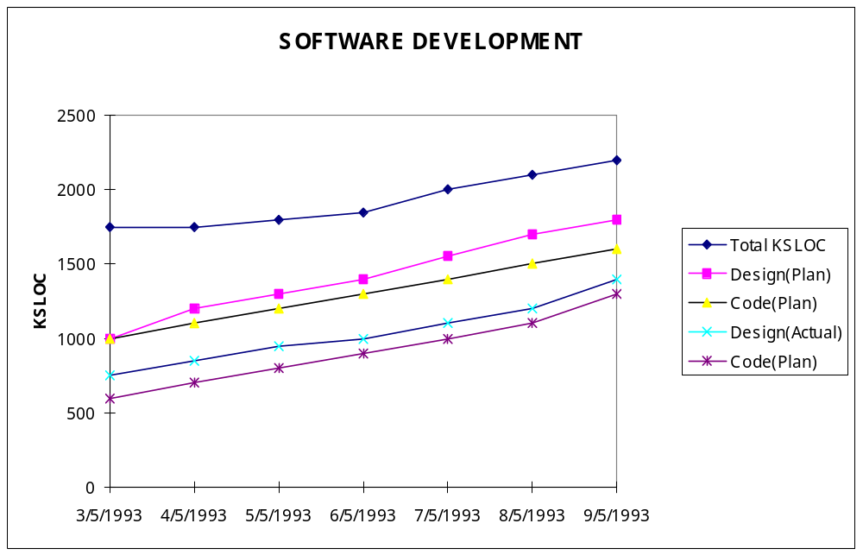
Contractor S/W Development

Slide 88
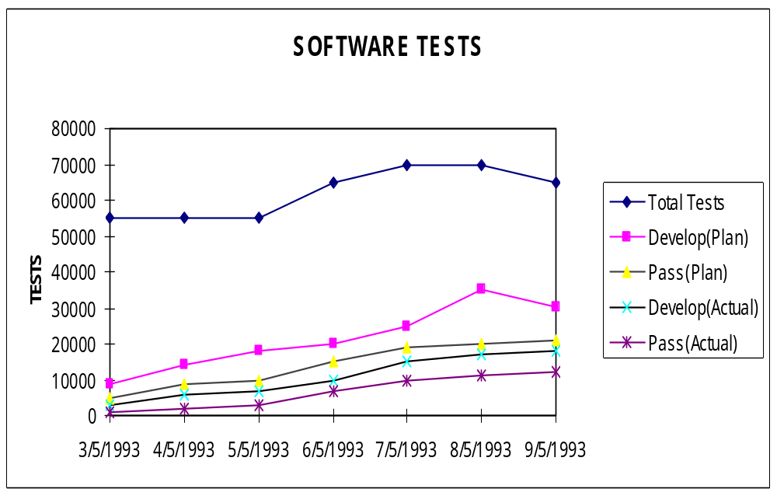
Contractor S/W Test

Slide 89
Readiness for Operational Test - Case Study
The S/W is presently in Software and System Integration and Test.
This phase should be completed by the 1st of April, and then proceed to the Operational Acceptance Test (OAT)
The key concern is the readiness of the s/w for Operational Test and Evaluation.
Your s/w contractor says the is “in good shape” and presents the following three metrics.
Analyze the metrics. What’s good, bad, potential problems? Can the plan be met?
  What Additional metrics would you request?
  What courses of action for the s/w sub, prime?

Slide 90
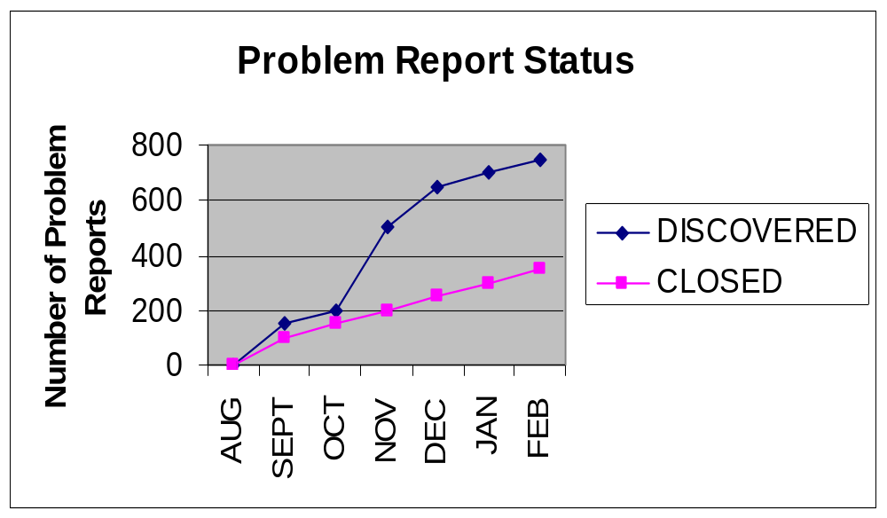
Readiness for Operational Test -1

Slide 91
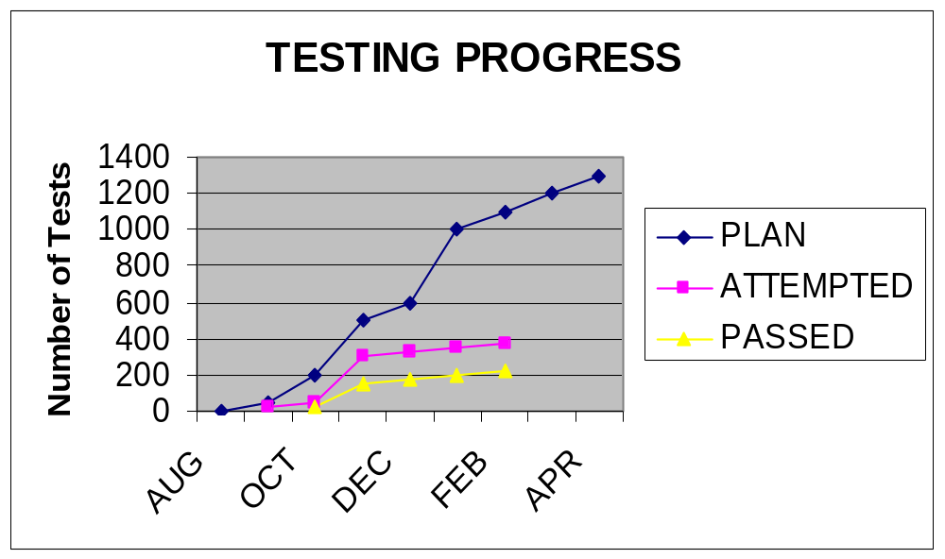
Readiness for Operational Test- 2

Slide 92
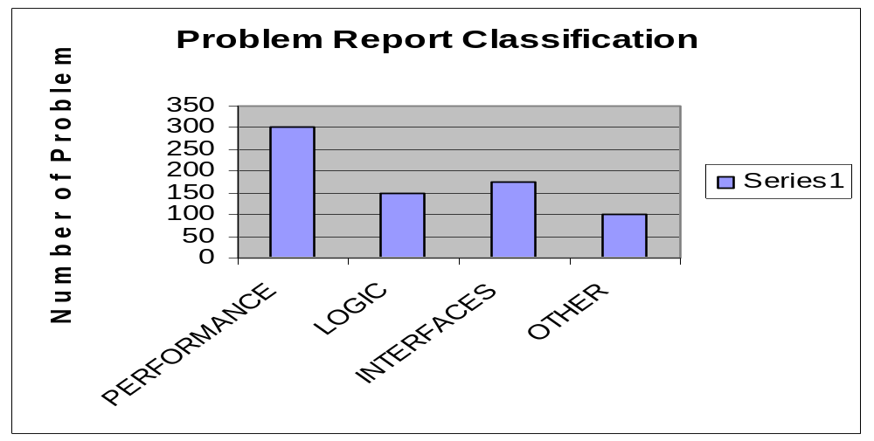
Readiness for Operational Test- 3

Slide 93
Readiness for Operational Test- 4
Analysis
  Analyze each metric separately
  Analyze all together, looking for relationships, inconsistencies,etc.

Slide 94
Test Completion Analysis 1, Case Study
The following four metrics were presented by your software subcontractor
  Analyze the metrics. What’s good, bad, potential future trends/problems? Can the original plan be met?
  What clarifications, or additional metrics would you request of the sub?
  What courses of action for sub, prime?

Slide 95
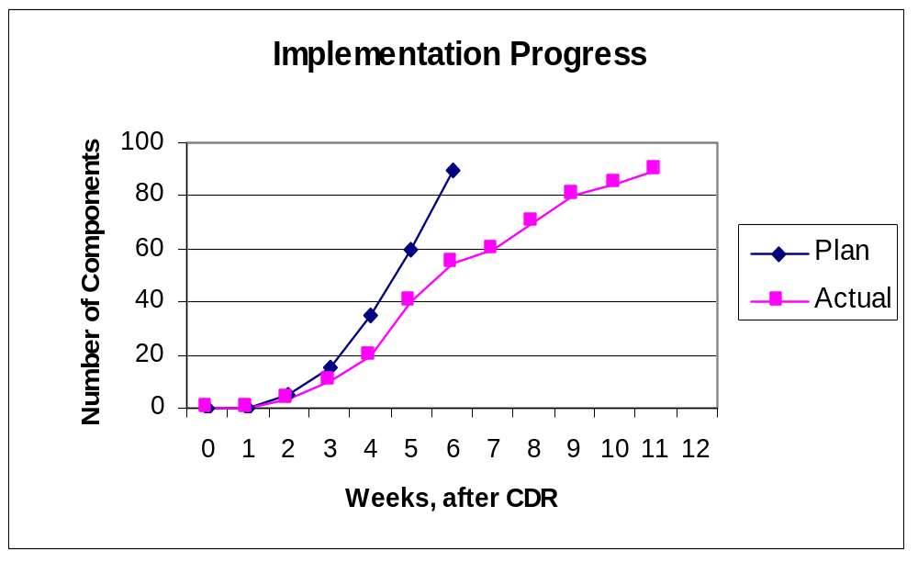
Test Completion Analysis 2, Case Study

Slide 96
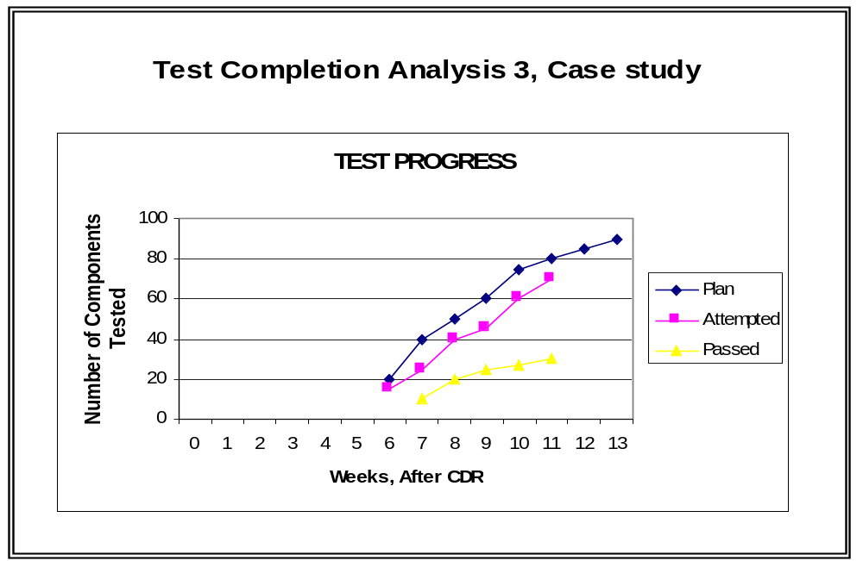
Test Completion Analysis 3, Case Study

Slide 97
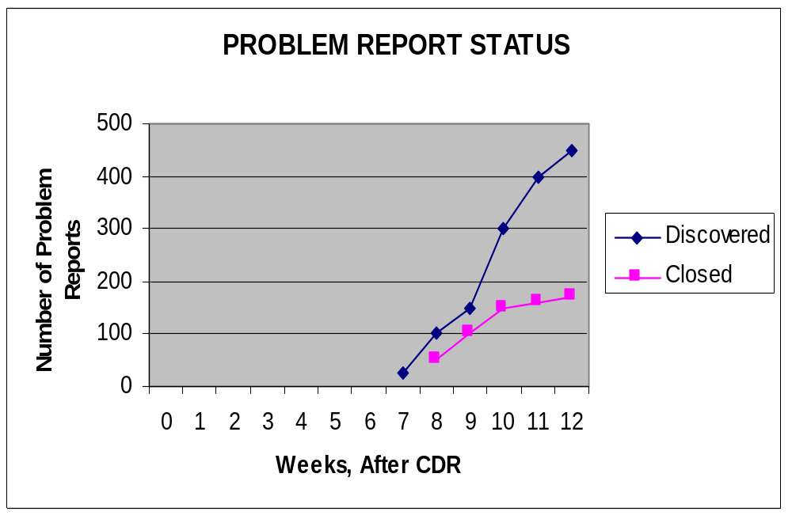
Test Completion Analysis 4, Case Study

Slide 98
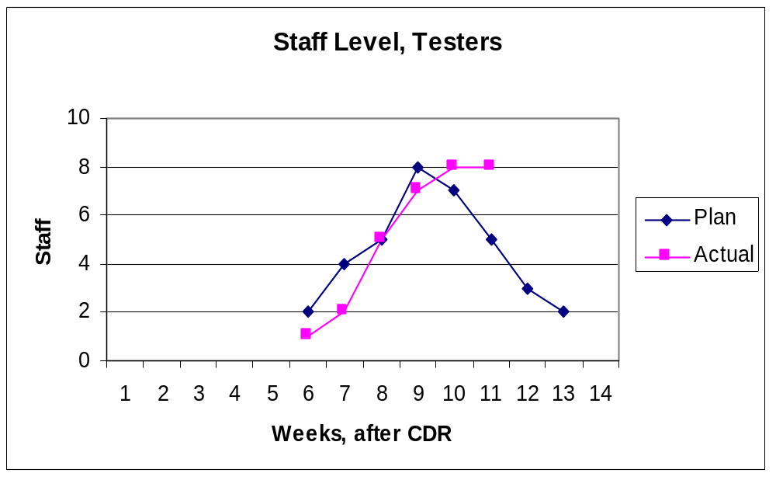
Test Completion Analysis 5, Case Study

Slide 99
Test Completion analysis 6, Case Study
Analysis of metrics.

Slide 100
Complexity Metrics
Topics
  McCabe’s Cyclomatic Complexity Metric
  Properties of the metric
  Flowgraphs
  Calculating the metric
  Identifying program paths for testing

Slide 101
Software Complexity Metric
Related to amount of work to code, test, and maintain a program
Easy to calculate
Language independent

Slide 102
McCabe’s Cyclomatic Complexity Number
Measures the amount of decision logic in a single software module
  V (G) = E – N + 2
  (e = edges, n = nodes )

Slide 103
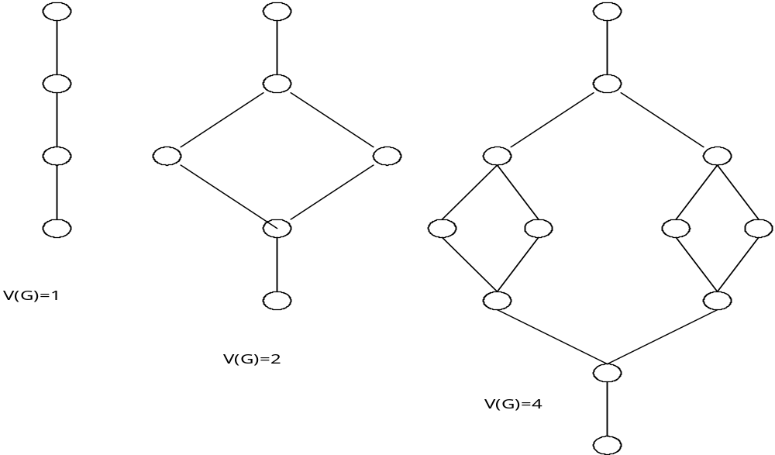
Flowgraphs
*

Slide 104
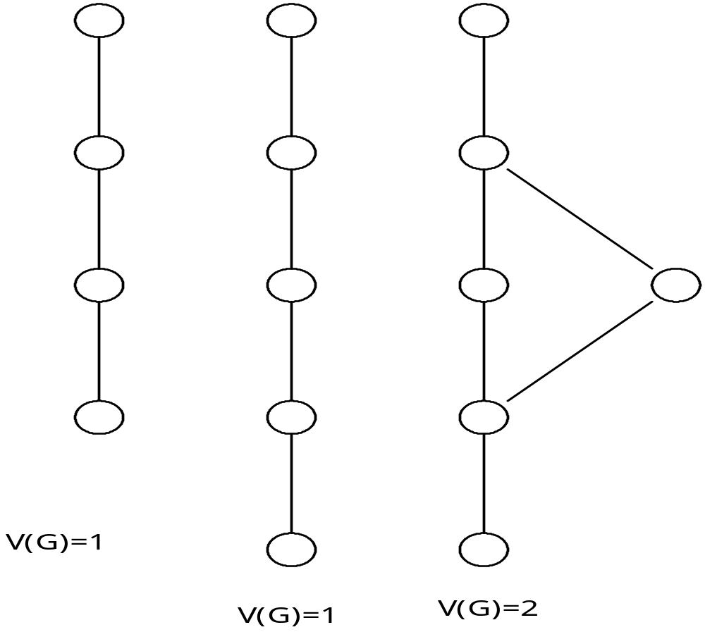
.
.

Slide 105
Properties of a Complexity V (G)
Adding a statement to an existing path
  V(G) =V(G)
Adding a statement along a new path
  V(G) =V(G)+1
Adding a new path
  V(G) =V(G)+1

Slide 106
Drawing the Flowgraph
Identify the following type of constructs:
  Linear sequences, branches or loops
Required items:
  Source code or design in PDL
Diagram the entire module using these schematics. When finished, add a terminal node (circle) to any arrows left at the bottom.
Label the flowgraph to show the correspondence to the design or code module.

Slide 107
Drawing The Flowgraph
Begin at the first step of the module
Represent each sequence of non-branching, non-looping instructions by:
Note: Draw one of these for the entire sequence of instructions, not one per instruction
Represent branching and looping as follows:
A structured (if-then-else) 2-way branch

Slide 108
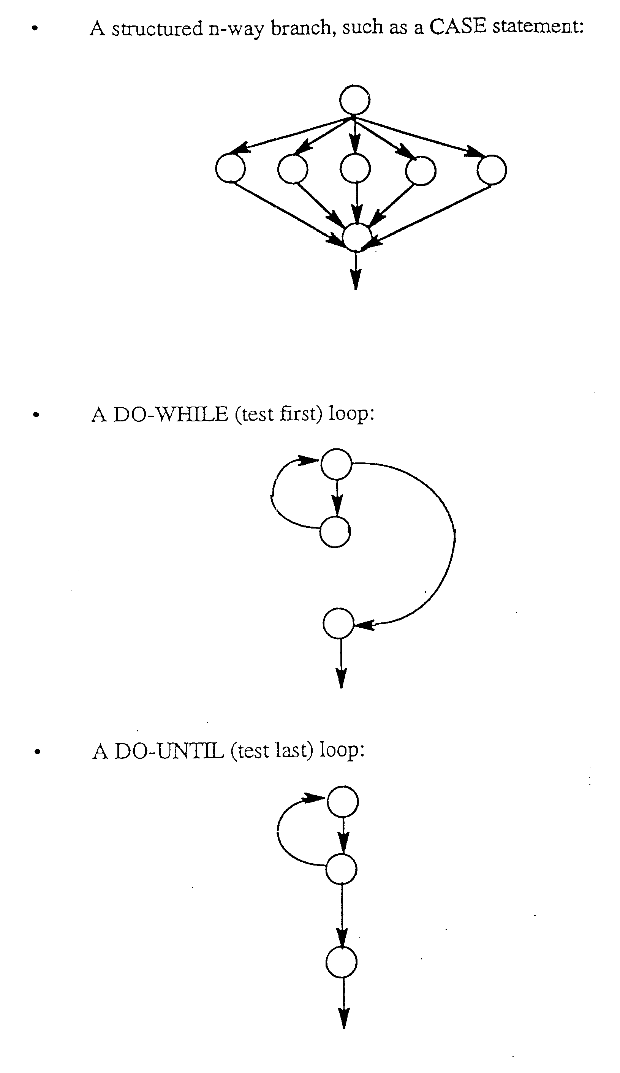

Slide 109
1 Read A,B
Read X,Y
2 If X gr Y
3 X=A+B
Y=A-B
Else
4 X=A-B
Y=A+B
5 ENDIF
6 N =1
7 Do While N=gr10
8 Array(N)=
X=X=A
N=N+1
9 ENDDO
10 Write X,Y
11 Stop

Slide 110
Calculating the Complexity
Calculate Complexity (C) = edges (e) - nodes (n) + 2
The Complexity (C) represents the number of independent paths through the module and the minimum number of test cases needed to test the module.
Complexity beyond 10 indicates that the module will be difficult to test and maintain.
  If complexity is greater then 10, divide module into to or more modules.

Slide 111
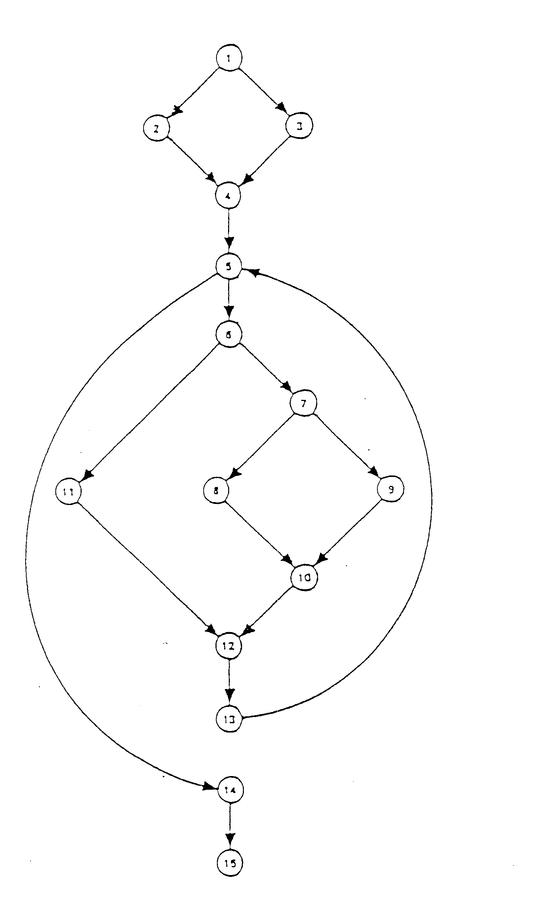

Slide 112
Identifying Paths for Testing
This procedure provides a systematic approach to selecting a set of paths to be used for testing.
  Pick a “basic path” through the program. This path should represent a “mainline” function, and should go through the module from beginning to end. Selection of this path is arbitrary: there is no one “correct” path.
  Record this basis path.

Slide 113
Identifying Paths To Be Tested
Identify a second path through the module by locating the first decision on the basis path, taking a different branch from the one taken on the basis path, then continuing along the basis path, if possible.
Identify the next path by taking the original branch of the basis path, taking a different branch on the second decision, and continuing along the basis path.

Slide 114
Identifying Paths To Be Tested
Exhaust all branches for the second decision.
Continue in this manner through all “decisions” on the basis path.
The number of paths equal the Complexity of the module.
Each outcome of each decision is exercised.
There are other paths through the module, this method provides a representative set, not a unique set, of paths.
Test developers can use the list of paths to plan test cases that will provide complete coverage of the module.

Slide 115
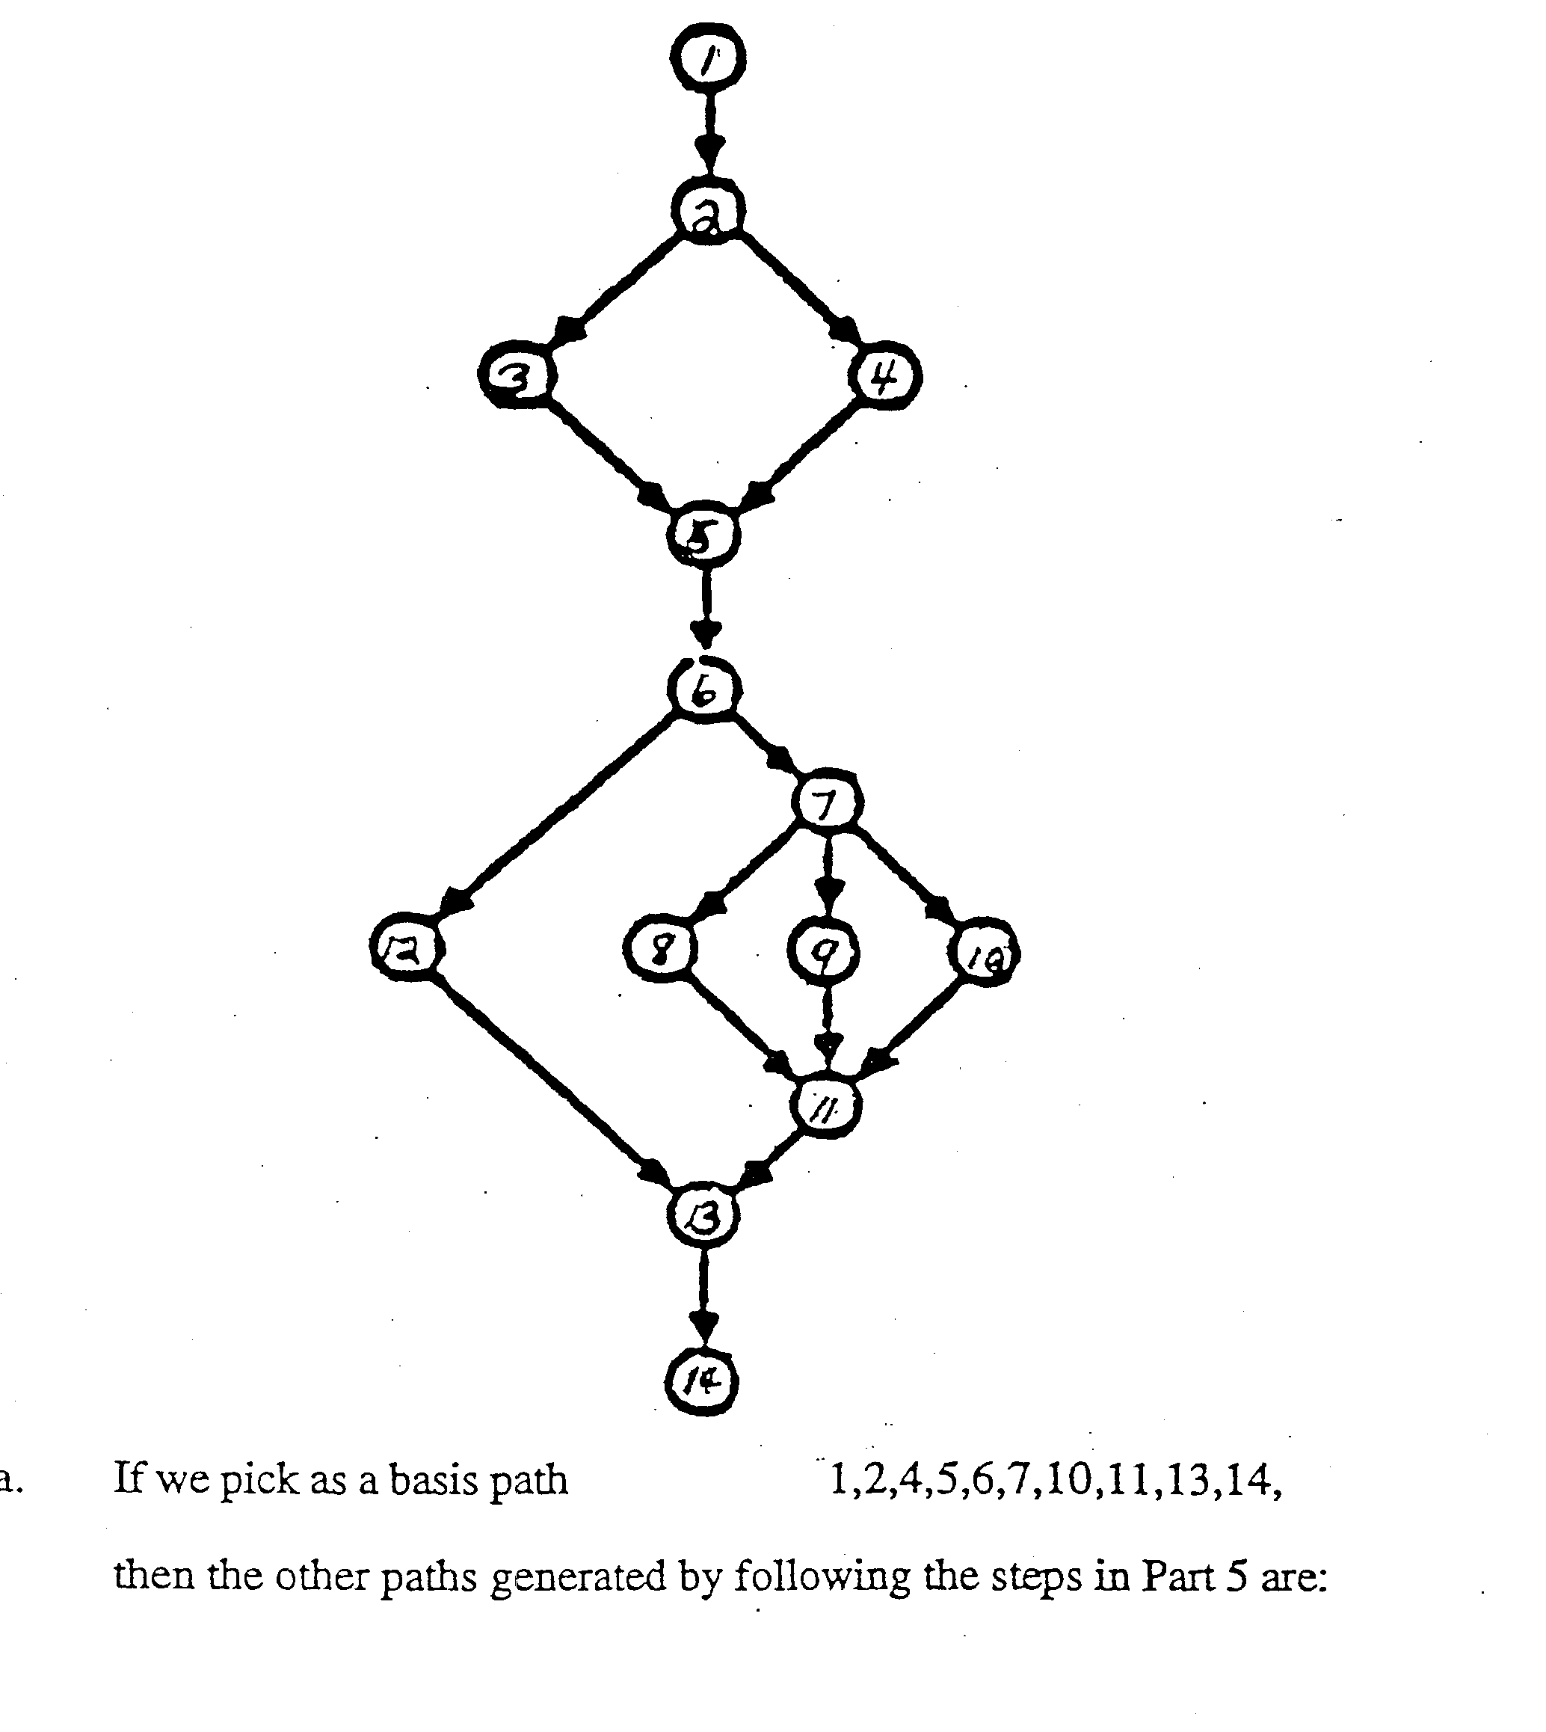

Slide 116
Empirical Evidence
Data collected on 276 modules of a weapons system
  Half of modules had V(G) less than 10
    Average error rate 4.6 per 1000 LOC
  Half had V(G) greater than 10
    average error rate 5.6 per 1000 LOC
Controlled experiment at GE
  Programmers were asked to locate and correct a single error in each of three programs.
  Significant correlation between V(G) and time required to locate and correct errors
  V(G) considerable better predictor than LOC
Errors in Unix operating system
  List of errors obtained
  Correlation between V(G) and number of errors was .96

Slide 117
Cyclomatic Complexity
Cyclomatic Complexity is the minimum number of paths that can, in (linear) combination, generate all possible paths through a module.
Executing a basis set of paths will always cover every control branch in the module. To cover all edges never requires more then the V(G) number of paths.
There are many sets of basis paths through a program.

Slide 118
Practical Application
Overly complex modules are harder to understand, test, and maintain.
By limiting the complexity number, V(G)
  We limit the number of independent paths in a program
  Testing/maintenance becomes more manageable
Design program and calculate complexity
If complexity greater than 10, redesign or modularize

Slide 119
McCabe’s Complexity — Summary
  Establishes a level of testing that is inherently related to the internal complexities of a program’s logic.
  Used to create a more testable and maintainable system by warning designers and implementers when a program has become too complex.
  Used to evaluate the alternate implementations with the goal of finding the simplest possible solution.
  Used as a more thorough and methodical testing process which quantifies the amount of work necessary for reliable testing.
  Viewed as an aid to the maintenance process by its strengthening of testing and the limiting of the complexity of the program to be fixed.
  Used on existing software to identify programs that will be difficult to maintain and extend. These are prime candidates for redesign.

Slide 120
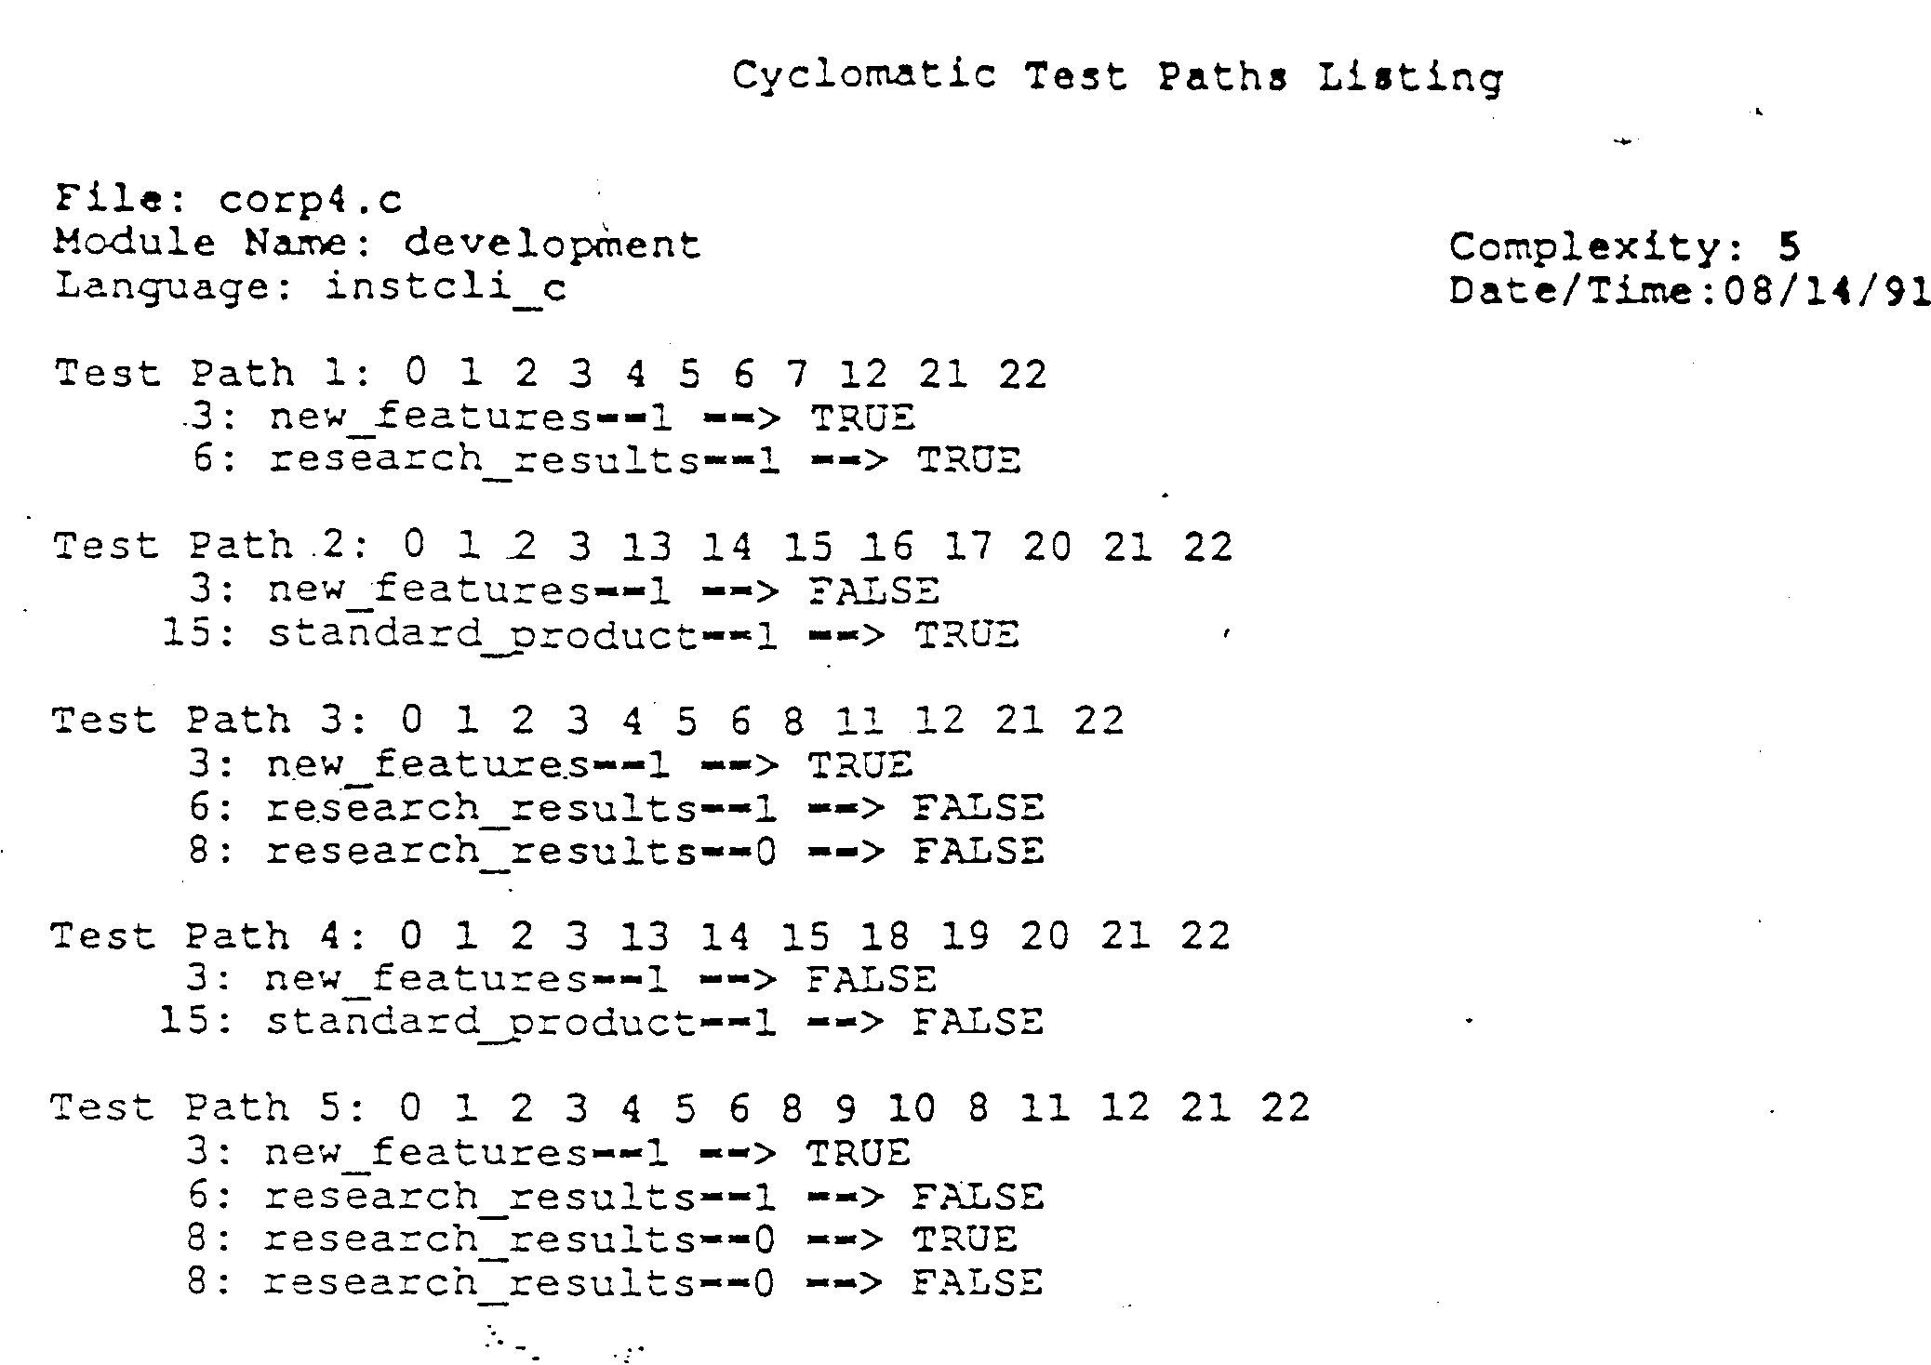

Slide 121
Software Defect Reduction Top-10 List
(NSF’s Center for Empirically-Based S/W Engineering (CeBASE)
www. CeBase.org)
1. Finding and fixing a software problem after delivery is often 100 times more expensive than finding and fixing it during the requirements and design phase.
  This insight has been a major driver in focusing industrial software practice on thorough requirements analysis and design, on early verification and validation to avoid costly downstream fixes.

Slide 122
Software Defect Reduction Top-10 List
2. About 40- 50% of the effort on current software projects is spent on avoidable rework.
  Avoidable rework is effort spent fixing difficulties with the software that could have been avoided or discovered earlier and less expensively.
  Most of the savings from improving software process maturity, software architectures, and software risk management came from reductions in avoidable rework.
  Reducing rework is a major source of productivity improvement
3. About 80% of the avoidable rework comes form 20% of the defects.
  A major sources of avoidable rework is hastily-specified requirements.
4. About 80% of the defects come from 20% of the modules and about half the modules are defect free.
  It is worth the effrt to identify high risk modules. Some factors are size, complexity, data coupling.

Slide 123
Software Defect Reduction Top-10 List
5. About 90% of the downtime comes from at most 10% of the defects.
  Understanding the operational profile of a system, and testing according is important
6. Peer reviews catch 60% of the defects.
  Studies have reported that design and code reviews caught 31% to 50% of the defects
  Fagan reported that 93% of all faults were found by inspections.
7. Perspective- based reviews catch 35% more defects than non- directed reviews.
  A scenario based reading technique offers a reviewer a set of formal procedures for defect detection based upon varying perspectives. Perspectives ( reading techniques) have been developed for requirements, testing, as well as user inspections.

Slide 124
Software Defect Reduction Top-10 List
8. Disciplined personal practices can reduce defect introduction rates by up to 75%.
  The CMM and the Personal Software Process (PSP) developed by Watts Humphrey
9. All other things being equal, it costs 50% more per source instruction to develop high- dependability software products than to develop low- dependability software products.
  A typical life cycle cost distribution is 30% development and 70% maintenance.
  The investment is more than worth it if significant operations and maintenance costs are involved.
10. About 40- 50% of user programs have nontrivial defects.

